Slide 1

Information Security Tool-Based project
Group Members
Shoaib Asghar 19i-0406
Abdul Manan 19i-0500
Umar Mansoor 19i-0594
Course Instructor
Mr. Abdullah Abid

Slide 2
Owasp Zap
Open-source
Web Application Security Testing Tool
Used for:
Vulnerability assessment
Penetration Testing (Pentesting)
Runtime Testing

Slide 3
Automated vs Manual Scan
Scanning Type (Active/Passive)
Scan Components of a Web app
Time Consume Parameter
Benefits
Drawbacks
Which one is slightly ahead?

Slide 4
List of features
Web Application Testing include:
File Fuzzer
Spidering
Web Sockets
Cross-site scripting, and
SQL Injection

Slide 5
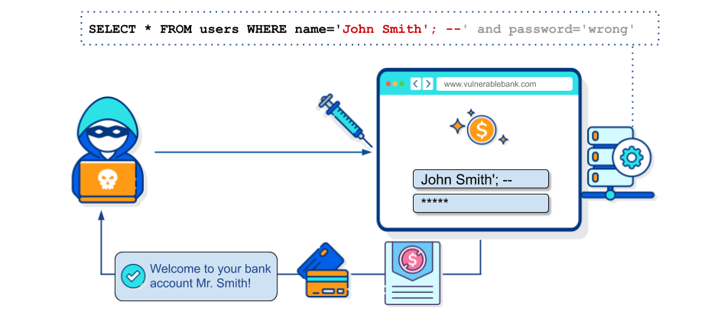
Use Case: SQL Injection
One of the most common web hacking techniques
Placement of malicious code in SQL statements
Attack via web page input
Might destroy databases

Slide 6
Conclusion
OWASP Zap is the #8 ranked solution in Application Security Tools
Decent UI
Performs decent job of finding vulnerabilities
Proper documentation for user guide
Easy to use

Slide 7
DEMO

